Slide 1
CS118 – Programming Fundamentals
Lecture # 05
Monday, September 02, 2019
FALL 2019
FAST – NUCES, Faisalabad Campus
Course Instructor:
Ebad Majeed
Slides credit:
Rizwan Ul Haq

Slide 2
Basic Components of C++ Program

Slide 3
World of Opportunities…
Computers are Universal …
Billions of general purpose computers
Billions more cell phones, smartphones & handheld devices
Number of mobile internet users reached more than 4,156 million by December 31, 2017…
Sale of smartphones surpassed PC sales in 2015…
By 2020, sale of smartphone applications market is expected to exceed $189 billion – creating abundance of business and other professional opportunities…
http://www.internetworldstats.com/stats.htm
https://www.statista.com/topics/1002/mobile-app-usage/

Slide 4
The Evolution of Programming Languages
Early computers were programmed in machine language
To calculate wages = rates * hours
In machine language:
100100 010001 //Load rates
100110 010010 //Multiply
100010 010011 //Store in wages

Slide 5
The Evolution of Programming Languages (cont'd.)
Assembly language instructions are mnemonic
Assembler: Translates a program written in assembly language into machine language
Notes:
Mnemonic pronounced as: (nuh-maa-nik) means reminder

Slide 6
The Evolution of Programming Languages (cont'd.)
Using assembly language instructions,
wages = rates * hours can be written as:
LOAD rate
MULT hour
STOR wages

Slide 7
The Evolution of Programming Languages (cont'd.)
High-level languages include Basic, FORTRAN, COBOL, Pascal, C, C++, C#, and Java
Compiler: Translates a program written in a high-level language to machine language
The equation wages = rate • hours can be written in C++ as:
wages = rate * hours ;

Slide 8
Assembly & Machine Language
Assembly Language
ST 1,[801]
ST 0,[802]
TOP: BEQ [802],10,BOT
INCR [802]
MUL [801],2,[803]
ST [803],[801]
JMP TOP
BOT: LD A,[801]
CALL PRINT
Machine Language
00100101 11010011
00100100 11010100
10001010 01001001 11110000
01000100 01010100
01001000 10100111 10100011
11100101 10101011 00000010 00101001
11010101
11010100 10101000
10010001 01000100

Slide 9
Equivalent C/C++ program
set memory[801] to hold 00000001
set memory[802] to hold 00000000
if memory[802] = 10 jump to instruction #8
increment memory[802]
set memory[803] to 2 times memory[801]
put memory[803] in to memory[801]
jump to instruction #3
print memory[801]
x=1;
i=0;
while (i!=10) {
i = i+1;
x = x*2;
}
printf("%d",x);
}

Slide 10
Compiler
C++ Program
int main() {
int i=1;
. . .
C++ Compiler
Machine
Language
Program
01001001
10010100
Created with text editor or development environment

Slide 11
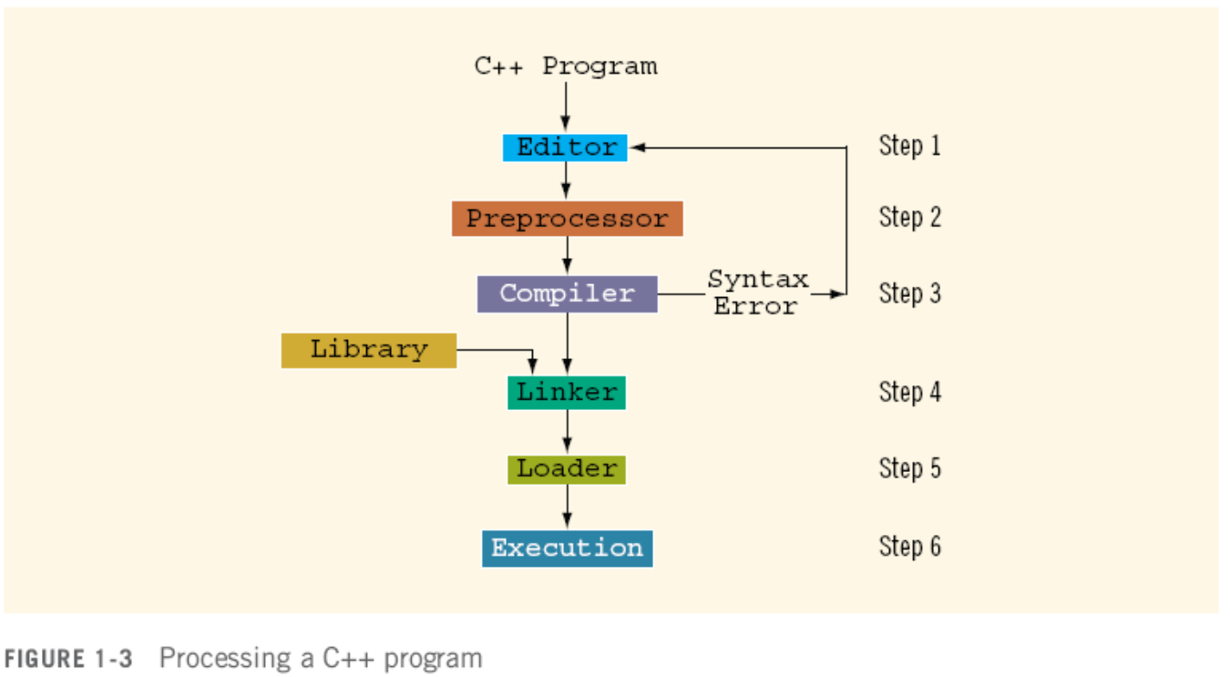
Processing a C++ Program

Slide 12
Basics of a Typical C++ Environment
Editor
Disk
Program is created in the editor and stored on disk
Phases of C++ Programs:
Edit
Preprocess
Compile
Link
Load
Execute
Preprocessor
Disk
Preprocessor program processes the code
Compiler
Disk
Compiler creates object code and stores it on disk.
Linker
Disk
Linker links the object
code with the libraries, creates a.exe and stores it on disk
Loader
Primary memory
. . .
Loader puts program
in memory
Disk
Primary memory
. . .
CPU takes each
instruction and
executes it, possibly
storing new data
values as the program executes.
CPU

Slide 13
Compilers
Translate high-level language to machine language
Check that the program obeys the rules
Source code
The original program in a high level language
Object code
The translated version in machine language

Slide 14
Linkers
Some programs we use are already compiled
Their object code is available for us to use
For example: Input and output routines
A Linker combines
The object code for the programs we write
and
The object code for the pre-compiled routines (of SDK) into
The machine language program the CPU can run
Loader:
Loads executable program into main memory
The last step is to execute the program

Slide 16
History of C and C++
History of C
Evolved from two other programming languages
BCPL and B: “Typeless” languages
Dennis Ritchie (Bell Lab): Added typing, other features
C is a programming language developed in the 1970's alongside the UNIX operating system
C provides a comprehensive set of features for handling a wide variety of applications, such as systems development and scientific computation
1989: ANSI standard/ ANSI/ISO 9899: 1990
History of C++
Early 1980s: Bjarne Stroustrup (Bell Lab)
Provides capabilities for object-oriented programming
Objects: reusable software components
Object-oriented programs
Building block approach” to creating programs
C++ programs are built from pieces called classes and functions
C++ standard library: Rich collections of existing classes and functions
Notes:
Basic Combined Programming Language (BCPL) is a computer language created by Martin Richards at the University of Cambridge in 1966.
B is a programming language developed at Bell Labs circa 1969. It is the work of Ken Thompson with Dennis Ritchie.
ANSI: American National Standard Institute

Slide 17
Structured/OO Programming
Structured programming (1960s)
Disciplined approach to writing programs
Clear, easy to test and debug, and easy to modify
e.g. Pascal: 1971: Niklaus Wirth
OOP
“Software reuse”
“Modularity”
“Extensible”
More understandable, better organized and easier to maintain than procedural programming

Slide 18
Basics of a Typical C++ Environment
C++ systems
Program-development environment
Integrated Development Environment (IDE)
Language
C++ Standard Library
C++ program names extensions
.cpp (C Plus Plus)
.c (C)

Slide 19
The C++ Standard Library
C/C++ programs consist of pieces/modules called functions
A programmer can create his own functions
Advantage: the programmer knows exactly how it works
Disadvantage: time consuming
Programmers will often use the C/C++ library functions
Use these as building blocks
Avoid re-inventing the wheel
If a pre-made function exists, generally best to use it rather than write your own
Library functions carefully written, efficient, and portable

Slide 20
Programming Style
C++ is a free-format language, which means that:
Extra blanks (spaces) or tabs before or after identifiers/operators are ignored
Blank lines are ignored by the compiler just like comments
Code can be indented in any way
There can be more than one statement on a single line
A single statement can continue over several lines

Slide 21
Programming Style (cont. )
In order to improve the readability of your program, use the following conventions:
Start the program with a header that tells what the program does
Use meaningful variable names and Camel notation
Document each variable declaration with a comment telling what the variable is used for
Place each executable statement on a single line
A segment of code is a sequence of executable statements that belong together
Use blank lines to separate different segments of code
Document each segment of code with a comment telling what the segment does.
Notes:
Camel notation examples: eBay, iPhone

Slide 22
C++ keywords
Keywords appear in blue in Visual C++
Each keyword has a predefined purpose in the language
Do not use keywords as variable and constant names!!
We shall cover most of the following keywords in this class:
bool, break, case, char, const, continue, do, default, double, else, extern, false, float, for, if, int, long, namespace, return, short, static, struct, switch, typedef, true, unsigned, void, while

Slide 23
Structure of a C++ Program
A C++ program is a collection of definitions and declarations:
data type definitions
global data declarations
function definitions (subroutines)
class definitions
a special function called
main() (where the action starts)

Slide 24
General form of a C++ program
// Program description
#include directives
int main()
{
constant declarations
variable declarations
executable statements
return 0;
}

Slide 25
Why int main () …?
void means that the function has no return-value, so you don't need return
int -- which is also implied for functions with no stated return-type -- means that the function should return an integer, so you must use return
The return-value of main() is also the return-value for the program, and it's value is often used to tell the operating-system if the program ran successfully or not. Typically a return-value of 0 (zero) tells that the program ran without a problem, while various non-zero values indicates different problems (e.g. 1=couldn't read a file, 2=bad arguments, 3=overflow). Some OSs define which values should be used with what type of errors, others let the programmer choose what he'd like for his program
You should use a main() of type int, and return a value (zero) at the end of your program. The revised language-definition for C++ makes int the only legal type for main() (many compilers will at least warn you otherwise)... For C, void as return-type for main() has never really been in use... So use "int main()" and "return 0".

Slide 26
When you use void main(), you're making a mistake. Please don't do it
C programming language: ISO 9899 paragraph 5.1.2.2.1.1 Program startup
The function called at program startup is named main. It shall be defined with a return type of int and with no parameters: int main(void) { /* ... */ } or with two parameters int main(int argc, char *argv[]) { /* ... */ } or equivalent.
C++ programming language : ISO 14882 paragraph 3.6.1 Main function
A program shall contain a global function called main, which is the designated start of the program [...] This function shall not be overloaded. It shall have a return type of type int, but otherwise its type is implementation-defined. All implementations shall allow both of the following definitions of main: int main() { /* ... */ } and int main(int argc, char* argv[]) { /* ... */ }

Slide 27
Includes
The statement: #include <myfile.h> inserts the contents of the file myfile.h inside your file before the compiler starts
Definitions that allow your program to use the functions and classes that make up the standard C++ library are in these files.
You can include your own file(s):
#include "myfile.h"

Slide 28
C++ compiler directives
Compiler directives appear in blue in Visual C++
The #include directive tells the compiler to include some already existing C++ code in your program
The included file is then linked with the program
There are two forms of #include statements:
#include <iostream> //for pre-defined files
#include “my_lib.h” //for user-defined files

Slide 29
The Preprocessor
Lines that start with the character '#' are special instructions to a preprocessor
The preprocessor can replace the line with something else:
include: replaced with contents of a file
Other directives tell the preprocessor to look for patterns in the program and do some fancy processing

Slide 30
C++ Preprocessor
C++ Compilers automatically invoke a preprocessor that takes care of #include statements and some other special directives
Definitions that allow your program to use the functions and classes that make up the standard C++ library are in these files
You don't need to do anything special to run the preprocessor - it happens automatically

Slide 31
Preprocessing
Temporary file
(C++ program)
C++
Preprocessor
C++
Compiler
C++ Program
Executable
Program

Slide 32
Preprocessor Directives
Preprocessor directives: Begin with #
Processed before compiling
# include
# define

Slide 33
Some common include statements
Basic I/O: iostream.h
Provides functionality of input and output
I/O manipulation: iomanip.h
Format’s the input and output
Standard Library: stdlib.h
Functions for memory allocation, process control, conversion etc.
Time and Date support: time.h
Functionality of time manipulation
Mathematics support: math.h
Functionality of basic mathematical functions

Slide 34
Basics of a Typical C++ Program Environment
Common Input/output functions
cin
Standard input stream
Normally keyboard
cout
Standard output stream
Normally computer screen
cerr
Standard error stream
Display error messages

Slide 35
I/O Streams and Standard I/O Devices
I/O: sequence of bytes (stream of bytes) from source to destination
Bytes are usually characters, unless program requires other types of information
Stream: Sequence of characters from source to destination
Input stream: Sequence of characters from an input device to the computer
Output stream: Sequence of characters from the computer to an output device

Slide 36
I/O Streams and Standard I/O Devices (cont'd.)
Use iostream header file to extract (receive) data from keyboard and send output to the screen
Contains definitions of two data types:
istream: input stream
ostream: output stream
Has two variables:
cin: stands for common input
cout: stands for common output

Slide 37
I/O Streams and Standard I/O Devices (cont'd.)
To use cin and cout, the preprocessor directive #include <iostream> must be used
Variable declaration is similar to:
istream cin;
ostream cout;
Input stream variables: type istream
Output stream variables: type ostream

Slide 38

Basics of a Typical C++ Program Environment
Insertion operator & extraction
Input stream object
>> (stream extraction operator)
Used with std::cin
Waits for user to input value, then press Enter (Return) key
Stores value in variable to right of operator
Converts value to variable data type
Use using namespace std; to reduce typing work

Slide 39
Basics of a Typical C++ Program Environment …
Standard output stream object
std::cout
“Connected” to screen
<<
Stream insertion operator
Value to right (right operand) inserted into output stream
Namespace
std:: specifies that entity belongs to “namespace” using binary scope resolution operator(::)
std:: removed through use of using statements
Escape characters: \
Indicates “special” character output

Slide 40
Questions

